Slide 1
Introduction to
Containers and Docker
Chase Hennion
August 14, 2019

Slide 2
Presentation Outline
Morning
Introductions
Session 1: Introduction to Containers and Docker
Break
Session 2: A Technical Overview of Docker
Break
Session 3: Docker Best Practices, Design Patterns and Use Cases
Lunch
Afternoon
Hands-On Docker Workshop
Bring a laptop (Linux, Macbook, Windows 10) to work on during the workshop.
We’ll get Docker installed during the workshop.

Slide 3
Who am I?
Graduated from OU in 2013 with a degree in Engineering Physics and a specialty in Computer Science.
Worked as a professional systems and software engineer for about 5 years now.
Worked with Docker for about 5 years.
Use Docker almost daily in development.
Used for unit testing, functional testing, integration testing, CI/CD pipelines, software packaging and delivery
Fallen into many Docker pitfalls over the years so I can help you avoid them!
Notes:
I’ve fallen into a lot of the Docker pitfalls

Slide 4
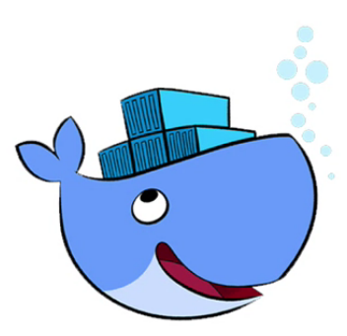
Introduction to Containers and Docker

Slide 5
Outline
What is a Container?
Brief History of Container Technology
Overview of Containers
Good and Bad Applications for Containers
Benefits of Containers
Containers vs Virtual Machines
What is Docker?
Architecture
Main Components

Slide 6
What is a Container?
A “box” that contains all of the packages, libraries, files, configuration etc. needed by an application or service.
A container contains all of the stuff that your application or service needs to run in isolation.

Slide 7

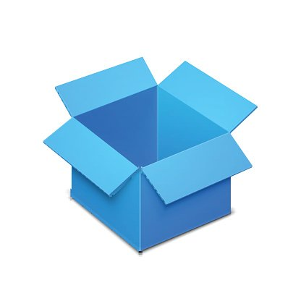



What is a Container?
default.conf
my-site.zip
nginx.conf
start-my-app.sh
My Container
Notes:
A container has all of your software and packages, configuration files, custom files and code, scripts etc.

Slide 8
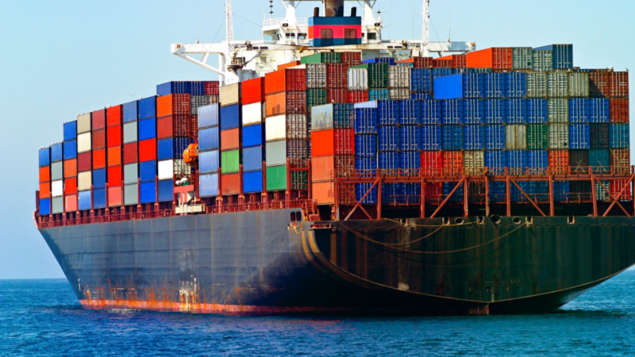
The Shipping Container Analogy
We can’t talk about containers without covering the standard shipping container analogy.

Slide 9
The Shipping Container Analogy Cont.
Imagine that you are responsible for packing a shipping container.
As the packer, you are concerned about making sure everything that needs to be in the container is included and that everything is packed correctly and securely.
Since you likely have to pack lots of containers, you create instructions for packing the container so you can pack each one the same way. This way you can hand off these instructions to other people so they can help pack containers too.

Slide 10
The Shipping Container Analogy Cont.
Once you are done packing your container, you transport it to a shipping yard.
At the shipping yard, the quartermaster takes the container from you and is then responsible for loading it on a ship safely.
The quartermaster doesn’t care or perhaps even know about the specific contents of the container, they just know the pertinent details needed for loading the container (it’s weight, dimensions etc.)
Since everything is packed up nicely in a standard container, it’s easy for the quartermaster to place the container wherever it fits on a ship.
The container can be placed alongside containers that may have wildly different contents and the quartermaster doesn’t need to worry about it.

Slide 11
The Shipping Container Analogy Cont.
Shipping containers are useful because they enforce uniformity. They all just look like boxes from the outside.
Since everything is in a nice box, it’s easy to stack these boxes and move them around. You don’t need to worry that much about what’s in the box.
This is why containers are useful!
Whoever is building the container worries about the internal details.
Once the container is packed, it just looks like a box.
You can move that box around and stack wherever it fits without even caring about what’s in it.

Slide 12
The Bottom Line
Putting stuff into boxes makes it easier to manage and move around.
You probably already knew that...
Thinking about this beyond shipping containers, if you need more analogies:
Moving Boxes
Luggage
Grocery bags
A container is just an implementation of this same idea but for software and applications.
The “stuff” in your container is all of your packages, libraries, files, scripts that you need to run an application.
Once all of your “stuff” is in the container, it’s easy to move that container around and run it on different computers.
Notes:
You don’t show up at the airport just carrying your clothes and toothbrush. You put that stuff in a bag.
Putting that stuff in a bag makes it easier to manage and makes it easier for your airline to move it between the terminal and planes etc.
You don’t just dump all of your stuff into a moving truck when you move. You put it in boxes so it’s easier to manage.
Imagine now instead of having all of your boxes labeled books, and games etc. they’re now labeled my-application, nginx, mysql etc.

Slide 13
What is a Container? - A More Technical Answer
A container is essentially a set of one or more processes that are isolated on a host.
Containers “contain” processes and applications in such a way that they are isolated from the underlying host.
Virtualized at the OS level. Shares the underlying host’s kernel with the host and all other containers on the host.
Once built, the container itself can be treated and managed as a single, atomic unit.

Slide 14
A Brief History of Containers
Containers were not invented by Docker.
Containers are not a new technology.
The underlying technology still used by containers, chroot, was introduced on Version 7 Unix in 1979!
chroot allows you to change the apparent root directory for a running process and its children, which is very useful for process isolation.
FreeBSD took chroot and began using it for virtualization since around 2000, when the jail command was introduced.
jail allowed system admins to partition a FreeBSD system into isolated mini-systems that all share the same kernel called jails.

Slide 15
A Brief History of Containers Cont.
Solaris included the capacity to deploy “zones” in 2004.
“Zones” are very similar to FreeBSD jails.
Could only make zones of the same Solaris version as the host or one version older.
Forced the use needlessly weird zone-in-zone deployments.
Cgroups were introduced to the Linux kernel in 2008 and would become a core technology that enables containers.
The LXC (Linux Containers) project was created shortly after the introduction of cgroups.
These technologies tended to be difficult to use which hindered mainstream adoption of containers.

Slide 16
Why are containers popular now?
If the underlying technology for containers has been around for awhile, why have they only really become popular in recent years?
Docker introduced tools that made working with containers simple. No specialized knowledge was required to get started with containers.
Docker enabled cross-platform container support. Previously container implementations were closely tied to specific operating systems.
Docker coincided with the rise of the DevOps movement. Docker made it easier for developers and admins to work together by using containers.
Notes:
This is mostly an opinion.

Slide 17
Why should I care about containers?
Containers are quicker to deploy and simpler to manage than VMs
Containers can be created from images in a few seconds with minimal overhead.
The creation and maintenance of container images is much simpler than maintaining VM images.
Container images are easily version controlled and hosted in image repositories.
Containers can be run on physical servers, VMs or via a variety of cloud services.
Container lifetime management is simpler than VMs. Containers are not designed to be manually patched and repaired by admins. If a container is broken, destroy the container, fix the image and redeploy.
Containers have a smaller attack surface than VMs and tend to be more secure out of the box. They do not contain and utilize administrative tools that could be exploited.
Containers allow you maximize your resource utilization. An single idle VM could run dozens of containers.

Slide 18
Why should I care about containers? Cont.
Ease of Management
Containers let you package up applications in a tidy, easy to manage “box”.
Applications experts and developers are involved in the creation of your container images. Once the image is built, it’s simple to create as many container instances as you want.
Management of the containers created from the image becomes simple. Admins don’t need to worry about package and software dependencies for the application in the container. All of those dependencies are already in the container!

Slide 19
Why should I care about containers? Cont.
Containers allow for you to package an application once and then run it almost anywhere.
All of the major cloud providers (AWS, GCP, Azure) have support for running containers in a variety of different ways.
These integrations make it easy to use application containerization as a means of enabling the migration of applications to the cloud.
Support from all major providers means your containers could feasibly be deployed across any major cloud platform and on-prim.
Running applications in containers greatly reduces the need for specialized infrastructure. The container itself has all of the prerequisite packages and configuration an app needs.
A container-centric approach drives uniformity in your infrastructure.

Slide 20
Why should I care about containers? Cont.
Containers help to facilitate DevOps practices
The creation of container images involves your software developers as well as your system engineers and admins.
The image creation process keeps everyone on the same page as to how an application is to be deployed and used.
No more cases where software developers toss a poorly documented application over the wall to system engineers for them to deploy and manage.
Well defined images can be used to make rapidly reproducible development environments with minimal configuration drift.
Your development environment can look and behave the same as production because you are using the same images.

Slide 21
Why should I care about containers? Cont.
Well designed containers scale easily and create loosely coupled application stacks.
A loosely coupled application stack allows for greater freedom in your application deployments.
Loosely coupled stacks also open up the opportunity for greater horizontal scaling, elastic scaling and advanced failover.
Loosely coupled stacks lend themselves easily to being deployed via a container orchestration tool like Kubernetes.

Slide 22
What applications work well in containers?
Web applications
Web apps are a natural fit for containers.
Exposing web application ports for web app containers is very simple to do.
Simple to break up LAMP-type application stacks into multiple containers for each component of the stack and network them together. This makes it easy to scale your web app too!
Open source software
Open source software in general is widely adopted and used in containers.
Oftentimes you can find pre-existing container images for a piece of open source software.
Many open source software projects come with Dockerfiles that allow for the building of container images for those projects.

Slide 23
What applications work well in containers? Cont.
Command line tools
Containers are very useful for command line tools that may require very specific software requirements to run.
Some good examples: NMAP, Java JARs, Make
Scalable applications
Well designed containers can easily run in isolation.
Following container design best practices will yield loosely coupled application stacks.
These loosely coupled stacks lend themselves easily to horizontal scaling.

Slide 24
What applications work poorly in containers?
Large, monolithic applications
Containers work best when they are focused on hosting and running a single application or process.
Monolithic applications almost always violate this paradigm and make it very difficult or impossible to break them up.
You can run these applications in containers, but they tend to be very large and slow. The resources savings vs running these applications on VMs tends to be negligible.
“Enterprise” Applications
These tend to require special tools, license files etc. to install and start up, which makes them a pain to create container images for.
Your mileage may vary depending on the application. Some may work just fine in containers.
Low-Level System Applications
Applications that access or modify the kernel don’t fit well in containers.
These applications can run in containers but keep in mind they will be altering the same kernel used by the host and and all other containers on the host.
Notes:
Important to call out that you can run these types of app in containers, it can just be painful and not worth the time in some cases.

Slide 25
What applications work poorly in containers? Cont.
Large Databases
In general, a variety of databases run just fine in containers.
There is widespread community support for running a variety of database engines (MySQL, MariaDB, Postgres etc.) in containers.
These containers work great for modest databases and for development. Just make sure you follow DB best practices to ensure you don’t lose data.
For large, production databases, you will likely need a cluster of database containers and replication to keep the databases performant.
Graphical, non-HTTP applications
Containers tend to be command line / terminal based in order to keep them small. Container images don’t tend to come with support for graphical interfaces.
You can mount in various display elements to get graphical applications to work but this also tends to reduce the portability of the image.

Slide 26
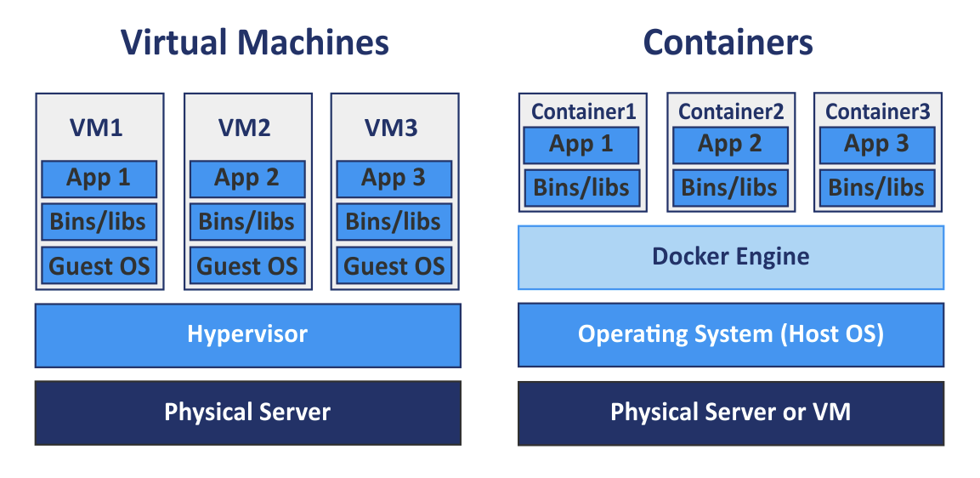
Containers vs Virtual Machines
Notes:
This is sort of the de facto standard diagram you find when you compare containers and VMs.
On one hand, it does highlight some of the similarities and major differences.
It’s important not to fall into the trap of thinking that Docker replaces the hypervisor. They behave very differently.
Don’t think of it as a hypervisor and containers like small VMs. Don’t attach your VM based ideas of management to containers,

Slide 27
Containers vs Virtual Machines Cont.
Both VMs and Containers provide a means for providing an isolated environment for applications and processes.
Virtual Machines
Require a Hypervisor for deployment and management.
VMs tend to be much larger than containers.
Completely isolated from the underlying host.
VMs tend to be used for more than a single application or process.
VMs tend to not be ephemeral. They are not readily destroyed and replaced.
Containers
Kernel-Level virtualization
Tend to be much smaller and quicker to deploy than VMs.
Containers are designed to run a single application or process.
Containers are designed to be ephemeral. The are designed to be destroyed and replaced.

Slide 28
Containers vs Virtual Machines Cont.
Containers and virtual machines should NOT be managed the same way.
Containers should:
Be Ephemeral.
Be rapidly reproducible.
Only run one service.
Only expose ports necessary for the service it is running.
Not expose or require traditional management services such as SSH and Sudo.
Not require additional manual configuration via shell access following deployment.
Admins should not login to containers to fix issues. Rather the container should be destroyed and re-deployed.
Issues should be addressed during the image build and deployment process.

Slide 29

What is Docker?
Docker is a set of tools that aid in the creation, deployment and management of containers.
Released as an open-source project in 2013
Interface on top of a low-level container runtime.
containerd, runc, lxc etc.
Consists of several components:
The Docker command line interface (CLI)
The Docker system daemon, dockerd
The Docker image registry
Docker made working with containers easy.
Similar to how Vagrant made working with VMs easy.

Slide 30
What is Docker? Cont.
Two Editions of Docker available
CE - Community Edition (Free, Open-source)
This presentation will focus exclusively on using the CE version of Docker.
EE - Enterprise Edition ($$$)
Can be installed and used on Linux, Mac and Windows 10.

Slide 31

Basic Docker Terminology
Container
An instance of a Docker image.
Ephemeral
Image
A reusable template for a Docker container.
Often stored in a Docker registry for widespread use.
Dockerfile
A file that defines a Docker image.
Can be built into a Docker image via the Docker CLI.
Often source controlled and used to periodically build images that are stored in a Docker registry.

Slide 32

Docker Architecture

Slide 33
Docker CLI
The Docker CLI is the main means of interacting with the Docker daemon.
Command line / terminal based. No GUI.
The Docker CLI is used to:
Start and stop containers.
Build and manage container images.
Inspect and manage running and stopped containers.
And much more.
The Docker API is RESTful. There are many freely available client libraries available in a variety of programming languages that can also be used to interact with the Docker API.

Slide 34
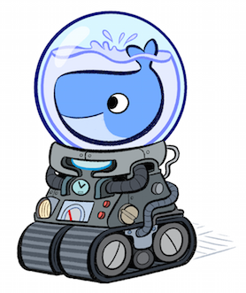
Docker Daemon
The Docker daemon is responsible for scheduling and running containers.
Exposes a RESTful API that the Docker CLI interacts with.
Runs as a standard Unix service, typically via systemd.
Typically bound to a Unix socket but can be externally exposed on a TCP port.
This is a potential security issue.
On Mac and Windows, this service is managed for you via Docker Desktop.

Slide 35
Docker Images
Docker images are used as the template for a containers.
Similar to a VM Image (ova, vmdk, qcow2 etc.)
Containers are instances of images.
The image defines the underlying packages, libraries, configuration etc. for the image.
Images are built from Dockerfiles.
Commonly used images are typically stored in image registries so that they don’t have to be continually rebuilt.

Slide 36
Dockerfiles
Dockerfiles define how a Docker image is to be built.
Dockerfiles are plaintext files written using the Dockerfile DSL.
A Dockerfile consists of a variety of directives that are used to specify how a Docker image is built.
This directives can include:
Defining the base image for the Dockerfile.
Specifying shell commands to run during the build of the image.
Specifying files and directories to copy into the image.
Exposing ports and volumes.
And much more.
Dockerfiles tend to be versioned alongside the code/software that they are building images for and they provide a useful, self-documenting template for how to deploy an application or piece of software.

Slide 37
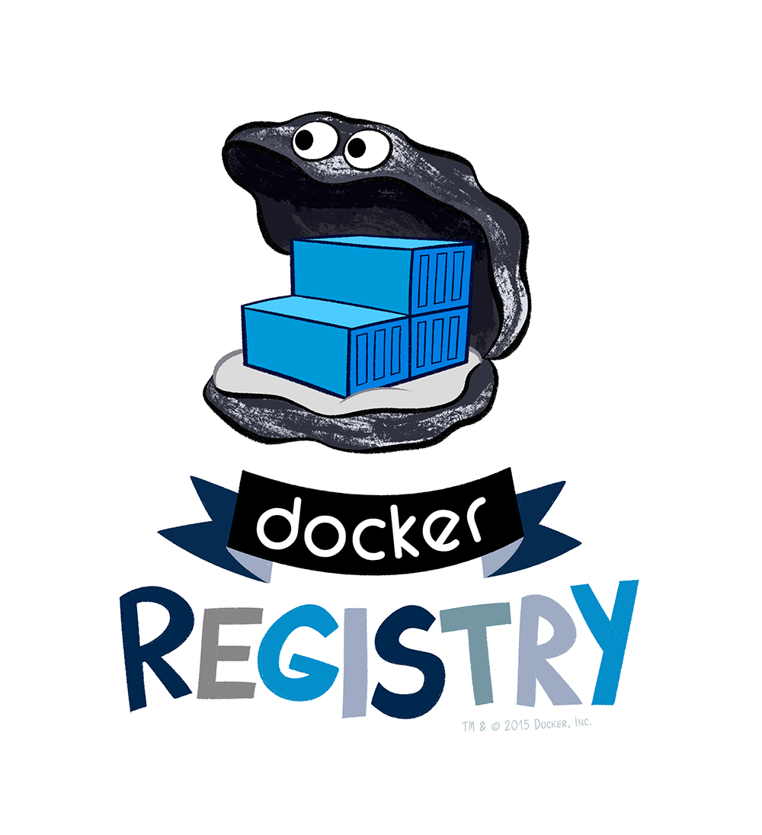
Docker Registry
A Docker registry is used to store images so that they may be easily downloaded and used by others.
Can easily run a Docker registry in a container itself for local image development and management.
Dockerhub is a common public image registry managed by Docker itself.

Slide 38
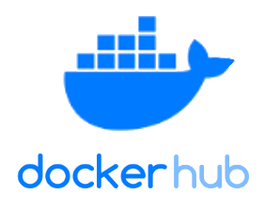
Dockerhub
Public repository of images
Free to use and contribute images
Many images are maintained by core OS/software developers and companies
Canonical supports Ubuntu images.
CentOS Project supports CentOS images
Docker verified images
Certified by Docker to adhere to exemplify practices.
Always start with Dockerhub before creating a new image. It’s likely someone in the community has already contributed an image you can use or base your image off of.

Slide 39

Questions?

Slide 40
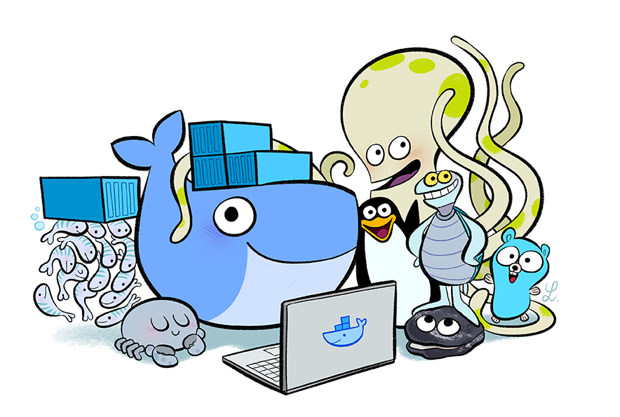
Let’s Take a Break

Slide 41
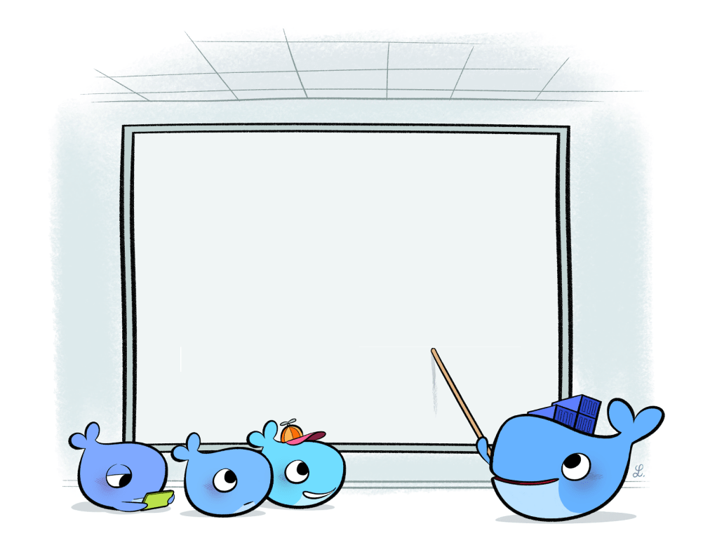
A Technical Overview of Docker

Slide 42
Outline
Dockerfiles and Docker Images
The Docker CLI
Docker Volumes
Docker Networking
Docker-Compose
Special Topics
Docker Images from Scratch
Privileged Containers
Windows Images and Containers
Docker Security

Slide 43
Dockerfiles
Dockerfiles are text files that define how a Docker image is built.
Dockerfiles contain a variety of directives that are used to copy in files, install packages and perform a variety of setup tasks during the build of the image.
Plain text files written in a simple DSL.
Let’s take a look at the various directives we can have in our Dockerfiles.

Slide 44
Common Dockerfile Directives
FROM
Used to specify the base image for the Dockerfile.
Required for every Dockerfile.
LABEL
Sets a metadata label.
Commonly used to specify the maintainer of the Dockerfile.
Show up in the container metadata when invoking docker inspect
A container can have as many labels as desired.
# Use nginx:1.17 from dockerhub as the base image.
FROM nginx:1.17
# Set the maintainer label
LABEL maintainer=”somebody@somewhere.com”

Slide 45
Common Dockerfile Directives Cont.
RUN
Used to execute shell commands during the build of the Dockerfile.
Commands must be non-interactive.
# BAD
# Apt will ask for confirmation before install.
# This will cause the build to break.
RUN apt-get install nginx
# GOOD
# The -y flag will prevent apt from asking for confirmation
RUN apt-get install -y nginx

Slide 46
Common Dockerfile Directives Cont.
COPY
Used to copy local files from the host into the Docker image.
Can also copy directories.
Can also change permissions and ownership of the file at runtime.
Files will be owned by root (UID: 0) in the image by default.
# Copy a file into the image.
COPY /path/on/host/myfile.txt /path/in/image/myfile.txt
# Copy a file into the image.
# Change the ownership of the file.
COPY --chown=www-data:www-data ./file.txt /file.txt
# Copy a directory into the image.
COPY ./my_dir /my_dir

Slide 47
Common Dockerfile Directives Cont.
ADD
Used to copy in files from the host into the Docker image.
Can be used to retrieve files from URLs unlike COPY.
Cannot handle files at URLS that require authentication.
Files will be owned by root (UID: 0) in the image by default.
Will automatically decompress local archives (.zip, .tar, .tar.gz etc.)
Does not apply to archives fetched from URLs.
# Add a local file into the image.
ADD --chown=www-data:www-data ./myfile.txt /myfile.txt
# Add a file from a URL
# Change the ownership of the file.
COPY --chown=www-data:www-data ./file.txt /file.txt

Slide 48
COPY vs ADD
ADD does more than COPY. Why not just always use ADD?
ADD automatic archive decompression may not always be desired.
If copying many files from URLs, having many ADD directives will add additional layers and potential bloat to your image.
If copying many files from URLs, a better approach would be to use cURL or wget in a script that is executed during the build of your image.
Files copied from URLs may only need to be present temporarily
Best Practice: Use COPY when the extra functionality of ADD is not required.

Slide 49
Common Dockerfile Directives
WORKDIR
Sets the working directory within the Docker image.
Will be created if it doesn’t exist
COPY, ADD, RUN directives will execute relative to the specified WORKDIR.
# Set /var/www/html as the current working directory.
WORKDIR /var/www/html
# Will copy myfile.txt into /var/www/html since
# /var/www/html is the working directory in the image.
COPY ./myfile.txt ./myfile.txt
# Will execute /var/www/html/myscript.sh
RUN ./myscript.sh

Slide 50
Common Dockerfile Directives Cont.
USER
Specifies the user to execute commands as within the container.
By default, command will be executed as root.
ENV
Used to specify an environment variable.
Environment variables can be passed in at runtime via the -e option.
# Run commands as the www-data user.
USER www-data
# Set the PATH environment variable.
# <var>=<value> format.
ENV PATH=/bin:/sbin
# <var> <value> format.
ENV PATH /bin:/sbin

Slide 51
Common Dockerfile Directives Cont.
EXPOSE
Used to expose a port.
By default, exposed ports will only be accessible via the Docker container’s private network interface.
Not required. Ports can be opened at runtime via the -p option.
# Expose port 80 for containers based on this image.
EXPOSE 80

Slide 52
Common Dockerfile Directives Cont.
ENTRYPOINT
Specifies the entrypoint script or command.
A Dockerfile can only have one ENTRYPOINT directive. If more than one is provided, the last ENTRYPOINT directive will be used.
Can be overwritten at runtime via the --entrypoint flag.
# Exec Command Format ← Preferred Format
ENTRYPOINT [ “ls” ]
# Shell Command Format
ENTRYPOINT ls

Slide 53
Common Dockerfile Directives Cont.
CMD
Specifies the default arguments to the entrypoint script.
A Dockerfile can only have one CMD directive. If more than one is provided, the last CMD directive will be used.
These arguments can be overwritten when a container is run via docker run
Can also include the entrypoint script itself. In this case, the Dockerfile should not include an ENTRYPOINT directive.
# Exec Command Format ← Preferred Format
CMD [ “-al”, “/etc ]
# Exec Command Format, including entrypoint script “ls”.
CMD [ “ls”, “-al”, “/etc” ]
# Shell Command Format
CMD ls -al /etc

Slide 54
CMD vs ENTRYPOINT
The CMD and ENTRYPOINT directives specify the script/command that containers created from the image will run by default.
It is possible to use CMD and ENTRYPOINT together or just CMD on it’s own.
# When a container built on this image is run without any additional arguments, it will execute the command ls -al /etc
# Set the entrypoint binary/script.
ENTRYPOINT [ “ls”, “-al” ]
# Specify default arguments to the entrypoint script
CMD [ “/etc” ]

Slide 55
Specifying CMD and ENTRYPOINT at runtime
It is possible to override the ENTRYPOINT and CMD directives at container runtime.
Suppose we built the image my-image:latest from the previous Dockerfile examples.
# Run with default entrypoint and cmd. Will execute ‘ls -al /etc’
$ docker run my-image:latest
# Override the default cmd. Will execute ‘ls -al /var’
$ docker run my-image:latest /var
# Override the entrypoint and cmd. Will execute ‘cat /etc/hosts’
$ docker run --entrypoint=/bin/cat my-image:latest /etc/hosts

Slide 56
CMD vs ENTRYPOINT Best Practices
Use an ENTRYPOINT and (optionally) a CMD when your image is providing general access to a script or binary.
This will allow users to easily provide customized arguments to the script or binary entrypoint and allows for easy image reuse.
Provide a CMD along with the ENTRYPOINT if there is a common default set of options/parameters that the binary or script should use.
Just use a CMD when your image is intended to only run a specific command without any input from the user.

Slide 57
Docker Build Context
When building a Docker image from a Dockerfile, the Dockerfile can only access files and directories at or below the directory where the Dockerfile resides.
This accessible directory tree called the “build context” of the Docker image.
When Docker builds an image, it recursively sends the whole build context to the Docker daemon.
Best Practice: Start with a directory with just your Dockerfile. Only add files that are required for the build to the directory.
Don’t use / as your build context!

Slide 58
Docker Image Layers
A Docker image consists of a set of read-only layers.
Every Dockerfile directive will generate a new layer in the image.
Can think of layers as the history of an image or the snapshot of the image at a certain stage of the image build.
Very similar to the Git commit history for a file.
Use docker history to view all of the layers within an image.
When a container is run, Docker places a writeable layer on top of the final layer of the image which allows the container to make changes to the filesystem.
Try to keep the number of layers in an image to a minimum otherwise you can easily bloat the size of your final image.

Slide 59
Docker Images, Layers and Size Example
Consider the following Dockerfiles. They do the same thing.
# Builds unoptimized:latest
FROM ubuntu:18.04
RUN apt-get update
RUN apt-get install -y wget
RUN wget https://www.websecurity.symantec.com/content/dam/websitesecurity/support/digicert/symantec/root/DigiCert_Global_Root_CA.pem
RUN apt-get remove -y wget
RUN apt-get clean
RUN rm -rf /var/lib/apt/lists*
# Builds optimized:latest
FROM ubuntu:18.04
RUN apt-get update \
&& apt-get install -y wget \
&& wget https://www.websecurity.symantec.com/content/dam/websitesecurity/support/digicert/symantec/root/DigiCert_Global_Root_CA.pem \
&& apt-get remove -y wget \
&& apt-get clean \
&& rm -rf /var/lib/apt/lists*

Slide 60
Docker Images, Layers and Size Example
$ docker images
REPOSITORY TAG IMAGE ID CREATED SIZE
optimized latest 0a3429002c5a 17 minutes ago 71MB
unoptimized latest d84e402aecf2 19 minutes ago 99.4MB
There’s almost a 30% difference in size between the unoptimized and optimized images even though the do the same thing!
Why is that?
Let’s look at the layers of the image.

Slide 61
Docker Images, Layers and Size Example
The optimized image only has one layer added to the image (the other layers are from the base Ubuntu image).
Since we clean up the apt cache and purge wget when we are done with it we are able to keep the single layer small.
$ docker history optimized:latest
IMAGE CREATED CREATED BY SIZE
0a3429002c5a 20 minutes ago /bin/sh -c apt-get update && apt-get insta… 6.85MB
3556258649b2 10 days ago /bin/sh -c #(nop) CMD ["/bin/bash"] 0B
<missing> 10 days ago /bin/sh -c mkdir -p /run/systemd && echo 'do… 7B
<missing> 10 days ago /bin/sh -c set -xe && echo '#!/bin/sh' > /… 745B
<missing> 10 days ago /bin/sh -c [ -z "$(apt-get indextargets)" ] 987kB
<missing> 10 days ago /bin/sh -c #(nop) ADD file:3ddd02d976792b6c6… 63.2MB

Slide 62
Docker Images, Layers and Size Example
The unoptimized image has several more layers.
Note that the cleanup layers have no size. They cannot change the size of a previous layer.
$ docker history unoptimized:latest
IMAGE CREATED CREATED BY SIZE
d84e402aecf2 22 minutes ago /bin/sh -c rm -rf /var/lib/apt/lists* 0B
77cbc551ce8f 22 minutes ago /bin/sh -c apt-get clean 0B
a4a321847e51 22 minutes ago /bin/sh -c apt-get remove -y wget 926kB
fcab06e2a544 22 minutes ago /bin/sh -c wget https://www.websecurity.syma… 1.36kB
2f84533140fa 22 minutes ago /bin/sh -c apt-get install -y wget 7.42MB
dc208be85dc6 22 minutes ago /bin/sh -c apt-get update 26.9MB
3556258649b2 10 days ago /bin/sh -c #(nop) CMD ["/bin/bash"] 0B
<missing> 10 days ago /bin/sh -c mkdir -p /run/systemd && echo 'do… 7B
<missing> 10 days ago /bin/sh -c set -xe && echo '#!/bin/sh' > /… 745B
<missing> 10 days ago /bin/sh -c [ -z "$(apt-get indextargets)" ] 987kB
<missing> 10 days ago /bin/sh -c #(nop) ADD file:3ddd02d976792b6c6… 63.2MB

Slide 63
Do Image Layers Always Add to the Size?
# Builds runtest_combined:latest
FROM ubuntu:18.04
RUN date && hostname -f && ls -al /etc
# Builds runtest_separate:latest
FROM ubuntu:18.04
RUN date
RUN hostname -f
RUN ls -al /etc
$ docker images
REPOSITORY TAG IMAGE ID CREATED SIZE
runtest_combined latest e143088a83b4 22 minutes ago 64.2MB
runtest_separate latest 29f27ad7f10e 21 minutes ago 64.2MB
These images are the same size!
Why is that?
Let’s look at the layers again.

Slide 64
Docker Images, Layers and Size Example
$ docker history runtest_combined:latest
IMAGE CREATED CREATED BY SIZE
e143088a83b4 24 minutes ago /bin/sh -c date && hostname -f && ls -al /etc 0B
3556258649b2 10 days ago /bin/sh -c #(nop) CMD ["/bin/bash"] 0B
<missing> 10 days ago /bin/sh -c mkdir -p /run/systemd && echo 'do… 7B
<missing> 10 days ago /bin/sh -c set -xe && echo '#!/bin/sh' > /… 745B
<missing> 10 days ago /bin/sh -c [ -z "$(apt-get indextargets)" ] 987kB
<missing> 10 days ago /bin/sh -c #(nop) ADD file:3ddd02d976792b6c6… 63.2MB
docker history runtest_separate:latest
IMAGE CREATED CREATED BY SIZE COMMENT
29f27ad7f10e 25 minutes ago /bin/sh -c ls -al /etc 0B
aef9eb231a50 25 minutes ago /bin/sh -c hostname -f 0B
b809621e0c9f 25 minutes ago /bin/sh -c date 0B
3556258649b2 10 days ago /bin/sh -c #(nop) CMD ["/bin/bash"] 0B
<missing> 10 days ago /bin/sh -c mkdir -p /run/systemd && echo 'do… 7B
<missing> 10 days ago /bin/sh -c set -xe && echo '#!/bin/sh' > /… 745B
<missing> 10 days ago /bin/sh -c [ -z "$(apt-get indextargets)" ] 987kB
<missing> 10 days ago /bin/sh -c #(nop) ADD file:3ddd02d976792b6c6… 63.2MB

Slide 65
Docker Images, Layers and Size Example
Those run commands did not contribute any size to the image.
Why is that?
These commands do not cause any change to the filesystem and thus do not contribute anything to the size of the final image.

Slide 66
But wait a minute...
apt-get clean and rm -rf /var/lib/apt/lists* definitely affect the filesystem.
Why didn’t they affect the size?
$ docker history unoptimized:latest
IMAGE CREATED CREATED BY SIZE
d84e402aecf2 22 minutes ago /bin/sh -c rm -rf /var/lib/apt/lists* 0B
77cbc551ce8f 22 minutes ago /bin/sh -c apt-get clean 0B
a4a321847e51 22 minutes ago /bin/sh -c apt-get remove -y wget 926kB
fcab06e2a544 22 minutes ago /bin/sh -c wget https://www.websecurity.syma… 1.36kB
2f84533140fa 22 minutes ago /bin/sh -c apt-get install -y wget 7.42MB
dc208be85dc6 22 minutes ago /bin/sh -c apt-get update 26.9MB
3556258649b2 10 days ago /bin/sh -c #(nop) CMD ["/bin/bash"] 0B
<missing> 10 days ago /bin/sh -c mkdir -p /run/systemd && echo 'do… 7B
<missing> 10 days ago /bin/sh -c set -xe && echo '#!/bin/sh' > /… 745B
<missing> 10 days ago /bin/sh -c [ -z "$(apt-get indextargets)" ] 987kB
<missing> 10 days ago /bin/sh -c #(nop) ADD file:3ddd02d976792b6c6… 63.2MB

Slide 67
What’s going on?
Even though those commands clean up files in the final image they are still present in previous image layers.
Docker essentially masks the files removed by those commands in the layers where they were “removed”.
The layers are the cumulative history of the image. Even if a newer layer changes something that was done in a previous layer, the state of the image is still the same in the previous layer.
Like a Git history. The history of a file is always stored and available even if the file is removed in a later commit.
The docker build command has an experimental option, --squash, which will squash all of your image layers into one image. We can use this option to compress the layers in unoptimized:latest.

Slide 68
--squash to the rescue!
If we build the unoptimized image with the --squash flag we see that the final image is the same size as the optimized image!
If you are familiar with Git, this behavior is analogous to squashing Git commits.
Keep in mind that --squash is still an experimental feature.
$ docker images
REPOSITORY TAG IMAGE ID CREATED SIZE
unoptimized_squashed latest 37a440a06f35 3 seconds ago 71MB
optimized latest 0a3429002c5a 17 minutes ago 71MB
unoptimized latest d84e402aecf2 19 minutes ago 99.4MB

Slide 69
What does --squash do to the image layers?
It merges them into one layer!
$ docker history unoptimized_squashed:latest
IMAGE CREATED CREATED BY SIZE COMMENT
37a440a06f35 20 seconds ago 6.85MB merge sha256:d84e402aecf2a34f2b20bce5076154bd239f6a92a070630a2979ccfe43435684 to sha256:3556258649b2ef23a41812be17377d32f568ed9f45150a26466d2ea26d926c32
<missing> About an hour ago /bin/sh -c rm -rf /var/lib/apt/lists* 0B
<missing> About an hour ago /bin/sh -c apt-get clean 0B
<missing> About an hour ago /bin/sh -c apt-get remove -y wget 0B
<missing> About an hour ago /bin/sh -c wget https://www.websecurity.syma… 0B
<missing> About an hour ago /bin/sh -c apt-get install -y wget 0B
<missing> About an hour ago /bin/sh -c apt-get update 0B
<missing> 10 days ago /bin/sh -c #(nop) CMD ["/bin/bash"] 0B
<missing> 10 days ago /bin/sh -c mkdir -p /run/systemd && echo 'do… 7B
<missing> 10 days ago /bin/sh -c set -xe && echo '#!/bin/sh' > /… 745B
<missing> 10 days ago /bin/sh -c [ -z "$(apt-get indextargets)" ] 987kB
<missing> 10 days ago /bin/sh -c #(nop) ADD file:3ddd02d976792b6c6… 63.2MB

Slide 70
Docker Image Layer Caching
Docker will cache the layers of an image during an image build.
If the directive associated with the layer has not been updated in the Dockerfile, Docker will used a cached copy of the layer to speed up the build process.
When a directive associated with a layer is updated, the cache will be invalidated for that layer and every subsequent layer in the image.
Can force Docker to rebuild all layers of an image via the --no-cache option.
Be wary of cached layers for things such as package installations etc. as Docker will not know if a new package installation would retrieve a newer version of a package.

Slide 71
Why not always build with --squash?
Why don’t we always build images with the --squash flag since it makes our images smaller?
Similar reason to why we don’t always squash Git commits. It can be useful having the layer history available, especially during development.
Can’t take advantage of layer caching if the layers are all squashed.
Best Practice: Build normally while developing an image. Push up a squashed image to your image registry once it has been completed.

Slide 72
Docker Image Tagging
When you build an image from a Dockerfile, you should include a descriptive tag.
A Docker image tag contains several important pieces of information about the image:
(Optional) The Registry where the image is located.
If omitted, Docker will assume the image is available on Dockerhub.
The name of the image.
The version of the image.
Can also tag existing images at any time via docker tag
Image
Name
Image
Version
Registry URL
my_docker_registry.com:3000/my_nginx:1.2.3
Notes:
Use docker tag to change registry etc.

Slide 73
Using the Docker CLI
Once a Dockerfile has been completed, it can then be built into an image and used to create containers via the Docker CLI.
The Docker CLI is essentially a REST client that interacts with the Docker daemon RESTful API.
The Docker CLI provides a simple interface for building and running containers, inspecting containers and interacting with the Docker daemon in a variety of ways.
Let’s take a look at several of the more common Docker CLI commands.

Slide 74
Common Docker Commands
docker run
Creates and starts a Docker container based on a given container Image
docker ps
Lists running and stopped/exited Docker containers.
$ docker run my-image:latest
# List only running containers.
$ docker ps
# List running and stopped containers.
$ docker ps -a

Slide 75
Common Docker Commands Cont.
docker pull
Pulls a Docker image from a image repository (usually Dockerhub)
docker build
Builds a Docker image from a Dockerfile
# Pull an nginx image from Dockerhub
$ docker pull nginx:latest
# Pull my-image:1.2.3 from my-registry
$ docker pull my-registry:3000/my-image:1.2.3.
# Build an image, my-image:latest, from a file called Dockerfile in /my-path
$ docker build -t my-image:latest /my-path
# Build an image from a Dockerfile not literally called Dockerfile
$ docker build -t my-image:latest -f /my-path/My-Dockerfile /my-path

Slide 76
Common Docker Commands Cont.
docker tag
Creates a new image tag that refers to an existing image.
Tags are used to determine the registry associated with a given image.
docker push
Pushes a Docker image to a Docker image registry.
# Tag the nginx image with a new name.
$ docker tag nginx:latest my-sweet-nginx:latest
# Tag my-image:1.2.3 with a new registry.
$ docker tag my-registry:3000/my-image:1.2.3 my-other-registry/my-image:1.2.3
# Push newly tagged my-image to my-other-registry
$ docker push my-other-registry/my-image:1.2.3

Slide 77
Common Docker Commands Cont.
docker logs
Gets the log messages printed to STDOUT from a given container.
docker cp
Copies file(s) out of a container.
# Get logs from container with ID fbfed2779717
$ docker logs fbfed2779717
# Copy my_file.txt out of container with ID fbfed2779717
$ docker cp fbfed2779717:path/in/container/my_file.txt /path/on/host/my_file.txt

Slide 78
Common Docker Commands Cont.
docker exec
Executes a given command within a Docker container.
# Execute ls -al /etc/ within container with ID fbfed2779717
$ docker exec fbfed2779717 ls -al /etc
# Start an interactive bash shell session.
$ docker exec -it fbfed2779717 /bin/bash
# Execute a command and redirect the output to a file on the host.
$ docker exec -i fbfed2779717 /usr/bin/mysqldump --user=user --password=password mydb > my_db.sql

Slide 79
Common Docker Commands Cont.
docker inspect
Returns low-level information about a given Docker container.
Can parse returned data with Go templates via the -f flag.
# Inspect container with ID fbfed2779717
$ docker inspect fbfed2779717
# Get the name of the container with ID fbfed2779717
$ docker inspect -f '{{.Name}}' fbfed2779717
# Get the IP address of the container with ID fbfed2779717
$ docker inspect -f '{{range .NetworkSettings.Networks}}{{.IPAddress}}{{end}}' fbfed2779717

Slide 80
Docker Volumes
Docker volumes are used to persist the data generated by a Docker container.
Volumes can be shared between containers.
Can create and manage volumes via the docker volume CLI.
There a variety of Docker volume plugin and drivers that allow for volumes to be backended by a variety of file system implementations.
GlusterFS, GCE persistent disks, AWS EFS etc.
There are three types of Docker volumes
volume
bind
tmpfs

Slide 81
Volume Type Volumes
The standard volume type for Docker.
A volume type volume is essentially a directory tree allocated and managed by Docker on the host filesystem that a container can write to. When the container is stopped, the data written to the volume is persisted.
The preferred way of handling persistent volumes in Docker.
Can be backended by a variety of file system and block storage systems via plugins.
Managed by Docker and supported across operating systems.

Slide 82
Bind-Mount Type Volumes
A Bind-Mount allows you to mount a directory or file from the host filesystem into a container.
Use a Bind-Mount when you want to provide data to a container and allow a container to optionally modify/update the data.
More limited than volumes.
Bind-Mounts require a full system path to the file or directory that is to be mounted.
Where possible, try to use volumes rather than Bind-Mounts to allow easier management and cross platform support.

Slide 83
Tmpfs Type Volumes
A tmpfs type volume is a volume whose contents are stored entirely in memory.
Good for I/O intensive and read-only applications.
Memory tends to be more limited than disk space.
Be cautious of letting a container consume too much memory!
Files written to a tmpfs mount cannot be persisted. Once the container stops, the tmpfs volume is removed.
Tmpfs volumes cannot be shared between containers.
Notes:
Don’t see tmpfs type volumes much.
Including them here mostly for completeness.

Slide 84
Docker Network Architecture
Docker creates and manages the network architecture required for your containers to connect to each other and the external internet.
When the Docker daemon starts, it will automatically create an initial private network and a bridged network interface (docker0) on your host.
The private network is used for IP address allocation for containers.
The bridged network interface allows containers to reach networks external to the Docker host via the public network interface of the host.
When a container is created, it will receive an IP address on the Docker private network by default and will appear as a veth network interface on the Docker host.
This IP address will only be reachable from the Docker host and from containers on the same private network.
Notes:
One of the cool things about Docker is that you can usually get by without knowing much

Slide 85
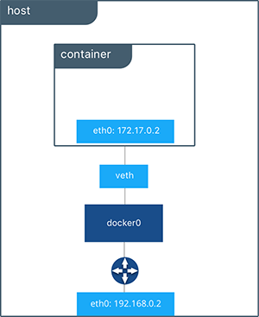
Docker Networking: A Simple Example
The container’s private IP address.
The container’s veth interface on the Docker host.
Docker’s bridge network interface.
The Docker host’s external network interface.

Slide 86
Docker Networking: Port Mapping
When a container is run, it is possible to map a port and a network interface from the Docker host to a port within the container.
This allows an application running inside a container to be reached via the IP address/FQDN of the Docker host on the exposed port.
This is done via the --publish, -p option for docker run.
# Map port 8080 to port 80 in the nginx container only on the loopback interface.
$ docker run -p 127.0.0.1:8080:80 nginx:1.17
# Check to see that the exposed port is in the LISTEN state.
$ netstat -tulpn
Proto Recv-Q Send-Q Local Address Foreign Address State PID/Program name
tcp 0 0 127.0.0.1:8080 0.0.0.0:* LISTEN 19112/docker-proxy

Slide 87
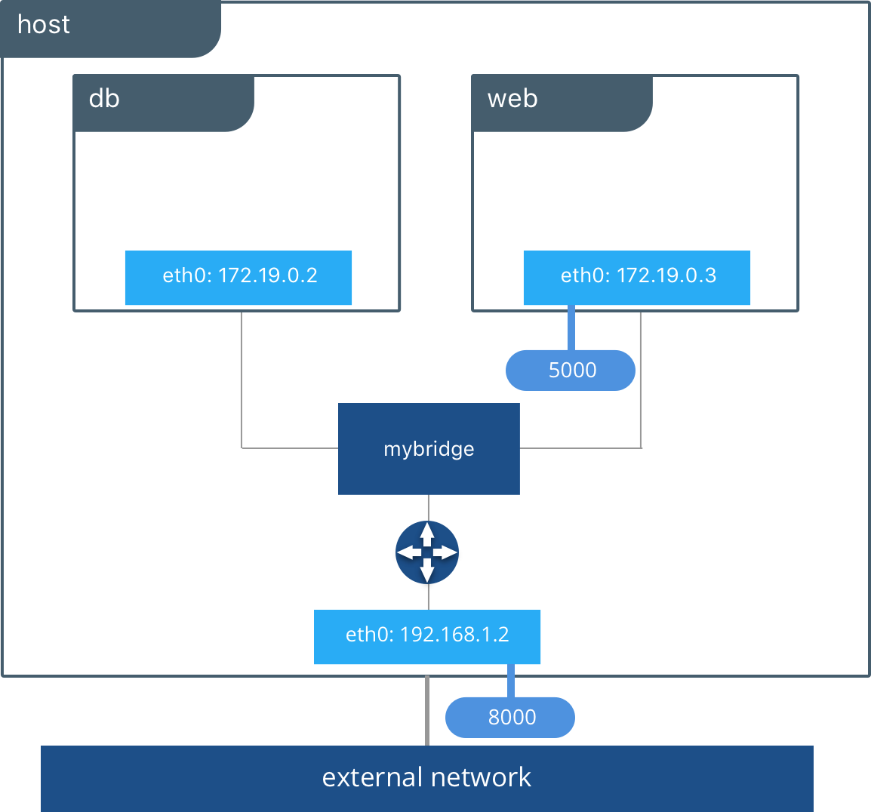
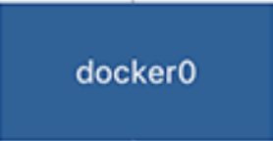
Docker Networking: Port Mapping
The web container has a port mapped. It is reachable via it’s private IP and via the eth0 interface on the Docker host via port 8000.
No port is mapped for the DB container. It is only reachable via it’s private IP.
The exposed port for the web container
Requests to
http://192.168.1.2:8000
will be routed to port 5000 in the web container.
The mapped port on the Docker host.

Slide 88
Advanced Docker Networking
It is possible to create additional Docker networks beyond docker0.
A container may be granted network interfaces on several different networks to enable cross network communication between containers.
There are also different types of network drivers beyond the standard bridge driver.
Host: Removes network isolation between containers and the Docker host.
Overlay: Used to connect multiple Docker daemons together for networking across hosts.
Macvlan: Assign MAC addresses to containers so they look like physical devices.
None: Don’t do any networking at all. Usually used alongside a custom plugin.
Or write your own network plugin.
Can also customize the DNS server used by containers.
By default, containers will use the resolv.conf from the host to handle DNS resolution.
Your Docker networking setup can be as simple or complex as you want.
Notes:
People tend to fall into two camps. Either they care a lot about their network topology or they just want their containers to be able to communicate and reach the public internet.

Slide 89
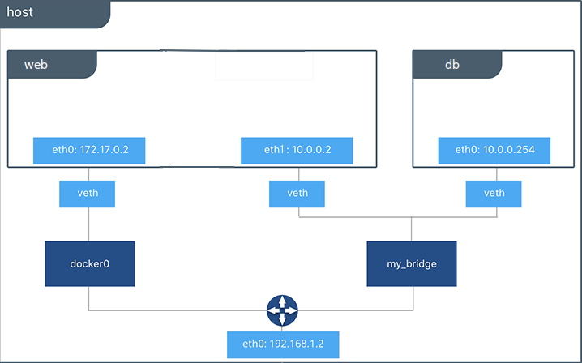
Advanced Docker Networking Example
Web’s IP on the my_bridge network.
Web’s IP on the docker0 network.
DB is only on the my_bridge network.
A newly defined bridge type Docker network.

Slide 90
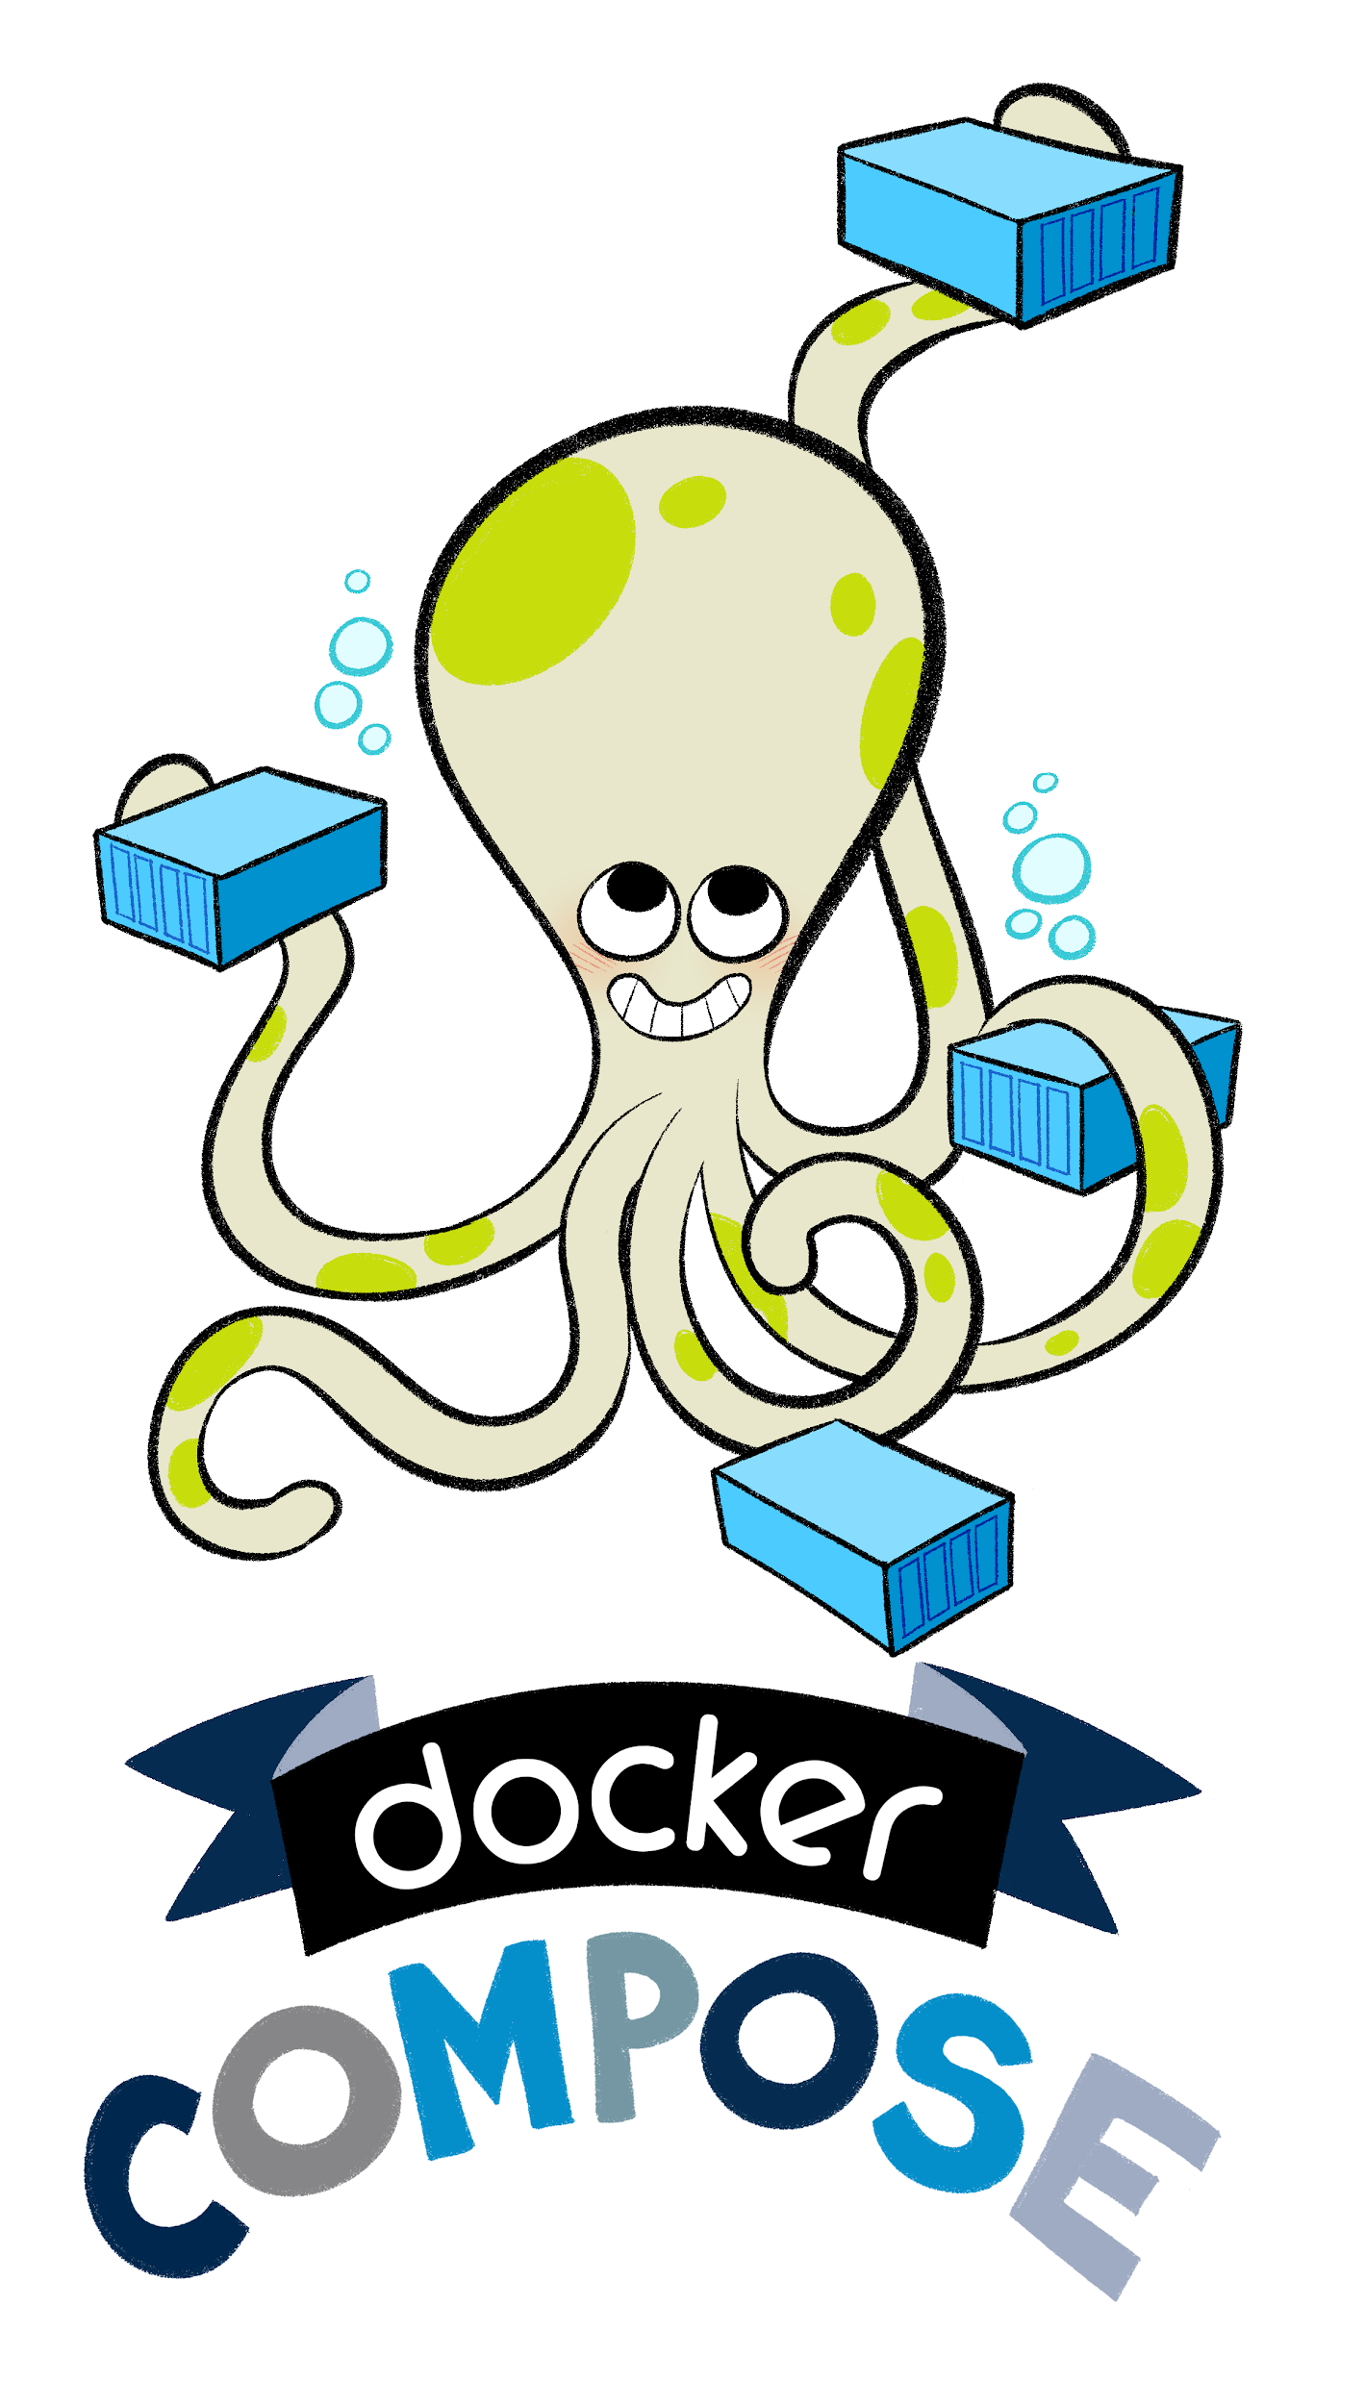
Docker-Compose
docker-compose is a tool for defining and running multi-container applications.
Very useful for deploying complete application stacks in separate containers locally.
Makes it simple to setup the networking required to allow many containers to communicate. Containers are resolvable via their service name defined in the compose file.
Application containers defined via a simple YAML DSL in docker-compose.yml files.
Let’s take a look at a few common docker-compose commands.
Notes:
Introduce docker-compose early when you start to investigate multi-container applications. It will make you life easier than fiddling around with running each container manually and then connecting them together.

Slide 91
Common docker-compose Commands
docker-compose up
Builds images (optionally) and starts the containers defined in a docker-compose.yml
docker-compose stop
Stops the containers defined in a docker-compose.yml.
# Start containers in docker-compose.yml in the background.
$ docker-compose up -d
# Build containers before starting.
$ docker-compose up -d --build
# Target a custom docker-compose.yml file.
$ docker-compose -f my-docker-compose.yml up -d
# Stop all containers defined in docker-compose.yml
$ docker-compose stop

Slide 92
Common docker-compose Commands Cont.
docker-compose restart
Restarts the containers define in a docker-compose.yml
docker-compose down
Stops containers defined in a docker-compose.yml and removes the network created by docker-compose for the container stack.
Can also be used to purge volumes used by the containers.
# Restart all containers defined in docker-compose.yml
$ docker-compose restart
# Restart my-container defined in docker-compose.yml
$ docker-compose restart my-container
# Stop containers in docker-compose.yml and remove network.
$ docker-compose down
# Also remove volumes.
$ docker-compose down -v

Slide 93
docker-compose.yml Example
Defines the Compose file format version.
version: '3'
services:
app:
build: ./path/to/app/Dockerfile/
ports:
- "127.0.0.1:5000:5000"
command: /start-my-app.sh
db:
image: "mysql:8"
Ports:
- "127.0.0.1:3306:3306"
volumes:
- db-data:/var/lib/mysql
volumes:
db-data:
Path to the Dockerfile for the “app” service.
Use a public image for the “db” service.
Save MySQL DB data to db-data volume.
Defines a named volume for persistent DB data

Slide 94
Special Topics: Docker Images from Scratch
The scratch image is the common ancestor of all Docker images.
The scratch image is empty. It cannot be pulled from Dockerhub and used to create containers on its own.
The scratch image is typically used for base OS images, like Debian and Ubuntu.
It can also be used to execute statically compiled binaries.
# A Debian base OS image example.
FROM scratch
# Copy in and decompress the root filesystem.
ADD rootfs.tar.xz /
CMD ["/bin/bash"]

Slide 95
Special Topics: Privileged Containers
Recall that containers are virtualized at the OS level and share the kernel with the Docker host.
What happens when the service running in a container needs to alter something in the kernel? Normally, a container cannot do this.
If you run a container with the --privileged flag, that will allow the container to access and alter the kernel.
This is useful if you are running a timekeeping service in a container (ntpd, chronyd etc.) or other services that require kernel access.
Use privileged containers very sparingly.
# Run a privileged container.
Docker run --privileged my_image:latest

Slide 96
Special Topics: Windows Containers
It is possible to build Windows Docker images and containers.
Some Restrictions and Gotchas
Can only run Windows containers on a host with the same version of Windows running.
Need to use Linux style paths in Windows Dockerfiles (forward slashes instead of backslashes) for Dockerfile directives.
Scripts and commands requiring paths should use standard Windows paths.
# Use a Windows Server base image.
FROM mcr.microsoft.com/windows/servercore:ltsc2019
# Copy in a Powershell script. Note Linux style path.
ADD script.ps1 /windows/temp/script.ps1
# Run the Powershell script. Note Windows style path.
RUN powershell.exe -executionpolicy bypass c:\windows\temp\script.ps1
Notes:
\

Slide 97
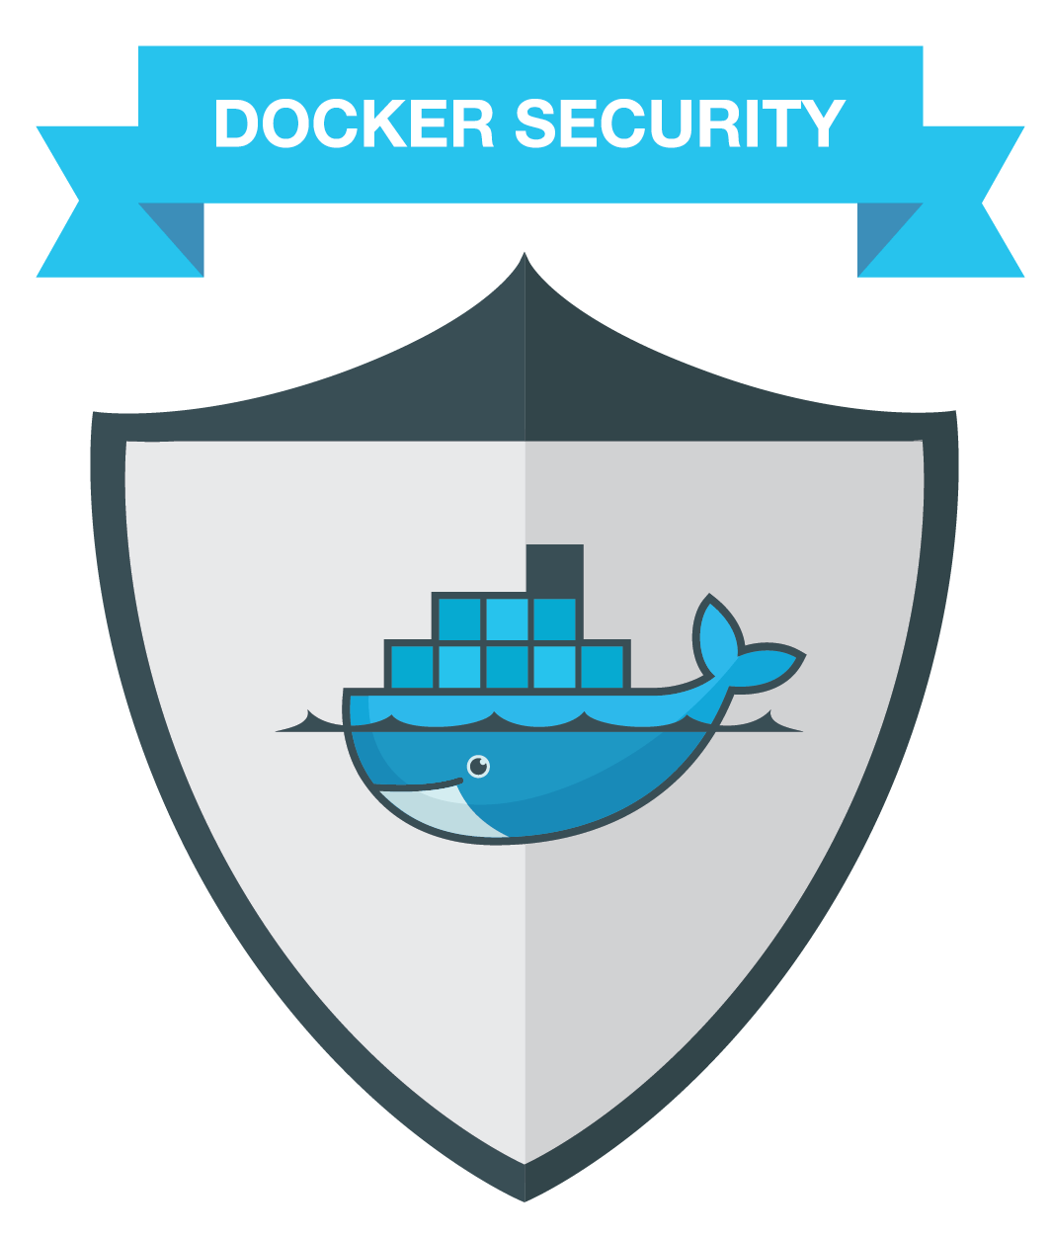
Special Topics: Docker Security
It is important to secure applications running within containers.
Well designed containers can be very secure compared to a VM.
There are three major security tiers to consider when securing Docker containers:
Application-Level Security
Container-Level Security
Docker Host-Level Security

Slide 98
Special Topics: Application-Level Security
Applications and software deployed in Docker images must be secure.
If deploying software that you maintain, follow best practices on software design and implementation.
If deploying third-party software, always deploy the latest security patched versions of the software.
Implement and follow best practices for application access control (good passwords etc.)
Avoid leaving backdoors, initial user accounts in applications.

Slide 99
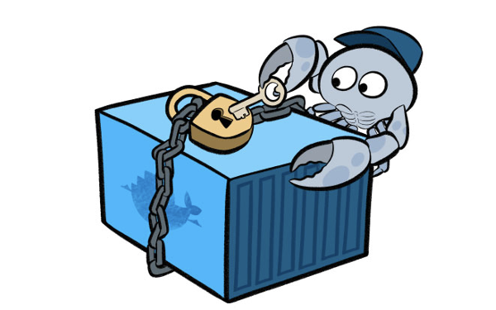
Special Topics: Container-Level Security
Following best practices for designing and building images and containers will yield containers that are easier to secure.
Don’t install extraneous packages.
Don’t open more ports than you need. Keep the attack surface for the container small.
Consider running commands and services within the container as a non-privileged user.
Keep the container up to date by rebuilding the container image when updates are available and redeploying the container.
DON’T PATCH RUNNING CONTAINERS! REBUILD THEM!

Slide 100
Special Topics: Docker Host-Level Security
Implement good practices on access control for your Docker hosts.
Don’t expose the Docker daemon on a TCP port.
Docker RBAC isn’t the best.
Keep access to the docker binary controlled via sudoers.
Keep your kernel patched and up to date.
Containers all share the host’s kernel.
An exploit that affects the kernel of the host will also affect the containers on the host.
Keep the Docker daemon patched and up to date.
Consider only allowing the Docker daemon to pull and run signed Docker images.
Consider using SELinux or AppArmor to further protect your Docker host kernel.

Slide 101
Questions?

Slide 102
Let’s Take a Break

Slide 103
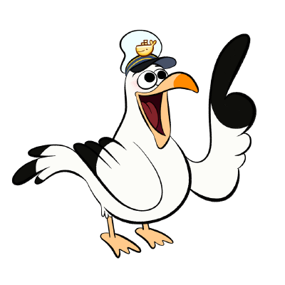
Docker Best Practices and Use Cases

Slide 104
Overview of Part 3
Docker Best Practices
Image Design
Environment Cleanliness
Common Docker Pitfalls and Gotchas
Docker Design Patterns
Docker and Container Use Cases
Container Orchestration Beyond docker-compose
Docker Integrations with Cloud Providers
Docker Success Stories

Slide 105
Docker Image Design Best Practices
Minimize the number of image layers.
Good practice to do this even when we have --squash.
If a layer is getting complex, consider offloading the layer logic to a dedicated script that can be added to the image and run during the build.
Don’t install extraneous packages.
If a package is only required for a single layer, remove it in the same layer.
Avoid leaving development/compilation tools and libraries in production images.
Run only one service per image.
Expose only the ports needed for the service.
Version your images with a documented standard. Don’t just use :latest.
Semantic Versioning (semver), Calendar Versioning (calver) etc.
Useful to place a version file or version env var in your image during a build as well. Helps debug the inevitable “It says I’m running :latest” issues.

Slide 106
Docker Image Design Best Practices Con.
Optimize your Dockerfile to allow for caching
Recall that a layer change will invalidate the cache of all following layers.
Put long running but infrequent directives at the beginning of the Dockerfile (heavy package installs etc.) so that this layer can be cached and reused.
Put short running and frequent directives at the end of the Dockerfile (source code copying etc)
Avoid hardcoding configuration for your application in your Dockerfiles.
Using environment variables to drive configuration works well. It’s easy to provide these arguments at runtime.
docker-compose also makes it simple to inject environment variables at runtime into container stacks. This makes environment variables ideal to use for specifying host information for other other containerized services.
For complex configuration, consider relying upon users to mount in configuration files at runtime.

Slide 107
Docker Environment Cleanliness
As you build more images and run more containers, you will likely see your file system fill up with old images, volumes and stopped containers.
From time to time, clean up old data in your environment
This can be done easily via the various docker prune command
docker image prune
docker volume prune
docker container prune
docker network prune
More extreme cleanup
docker system prune -a --volumes

Slide 108
Gotcha: Docker-In-Docker
There seems to always come a point where you want to run Docker inside a Docker container.
This is a BAD idea. Performance will be poor and data integrity will be questionable at best.
A better solution: Mount the Docker socket into the container that needs to run docker commands.
This allows the container to spin up sibling Docker containers and achieves similar functionality.
# Mount in the Docker socket so my_container can interact with Docker.
$ docker run -d -v /var/run/docker.sock:/var/run/docker.sock my_container:latest
Notes:
-v /var/run/docker.sock:/var/run/docker.sock

Slide 109
Gotcha: Image Caching
Docker caches image layers during image builds in order to speed up the image building process.
Suppose a package version in a build was updated. How does Docker know that the package installation will be different in this build?
It doesn’t!
Docker won’t try to rebuild the layer unless the layer has been explicitly updated in the Dockerfile.
In cases like these, you need to build the image with the --no-cache flag so that all layers will be rebuilt.
# Build my-image:1.2.3 with the --no-cache option.
$ docker build --no-cache my-image:1.2.3 path/to/my/Dockerfile/

Slide 110
Gotcha: Bind Mount Permissions
When a bind mount is mounted into a container, it keeps the same permissions as on the host.
What if the host user doesn’t exist in the container? What if a process in the container isn’t running as root?
In cases where files need to be accessed by non-root users within a container, be sure to update the permissions of the bind-mount prior to mounting it into the container.

Slide 111
Gotcha: Service Management in Containers
On a regular Linux host, you typically manage services via systemctl or service.
This doesn’t work in containers.
A container’s lifetime is tied directly to it’s CMD. If the CMD exits, the container exits.
A container should use foregrounded scripts/binaries instead of trying to manage services via a service management framework.
If a script or binary requires some setup before being run, consider creating a script as your entrypoint that handles this setup.

Slide 112
Gotcha: Is :latest really :latest?
If you always work with :latest there will inevitably come a point where your version of :latest differs from another’s version of :latest.
This can be difficult to detect without checking the image version hash.
Always tag images that you are going to distribute with a documented standard.
The :latest tag should always be an alias for a standard version tag.
Avoiding using :latest outside of development.

Slide 113
Docker Design Patterns
Design patterns utilizing Docker and containers are still very much under development and are not as well established as other software and infrastructure design patterns.
There are several patterns that have emerged in recent years that seem to have gained traction in the Docker community.
A few design patterns that I’ve found success with:
Multi-Stage Build Pattern
Sidecar Pattern
Worker Queue Pattern

Slide 114
Multi-Stage Build Pattern
As part of an image build, you may run into scenarios where you require many libraries/packages in order to produce artifacts.
Source code compilation, download and extraction of archives etc.
Keeping all of these tools in your image causes image bloat.
The multi-stage build pattern addresses this. This pattern allows a single Dockerfile to be split into separate stages, each with their own set of layers.
Produce your artifacts in the stage where you download and install all of the relevant tools you need. Copy the artifacts from this stage into your final image and discard the earlier stage.
This can be useful for maintaining a development and production image in the same Dockerfile.
Unlike other patterns, this pattern is actually a newer feature of Dockerfiles.

Slide 115
Multi-Stage Build Dockerfile Example
FROM ubuntu:18.04 as code_compiler
RUN apt-get update && \
apt-get install -y gcc make
COPY ./my-app-src /my-app-src
WORKDIR my-app-src
RUN make
FROM ubuntu:18.04
COPY --from code_compiler /my-app-src/bin/somebinary /bin
Install heavy packages needed for artifact creation.
Generate
Artifacts.
Copy artifacts into final image and discard previous layers.

Slide 116
Sidecar Pattern
A well designed container has one responsibility / runs one service.
How do we handle scenarios where an important but otherwise unrelated service needs to run alongside a container’s service?
For example, what if a web server also needed a service for handling log aggregation?
We can use the sidecar pattern for this.
Decouple services into separate containers but share pertinent data between containers via shared volumes.
The web server can write logs as usual and the log aggregation container can have access to the logs via a shared volume.

Slide 117
Worker Queue Pattern
Containers lend themselves well to batch processing and the worker queue pattern leverages this.
Design a “master” container that can ingest and delegate batch tasks to “worker” containers via a message queue system.
Design “worker” containers that can easily be horizontally scaled and can operate independently of one another.
docker-compose has the --scale option to easily do this.
“Worker” containers fetch batch tasks from the message queue and process them.
Scale the number of “worker” containers based upon need.

Slide 118
Docker and Container Use Cases
Docker and Containers lend themselves well to a variety of different use cases.
A few good use cases:
Reproducible Development Environment
Software Testing
CI/CD
Software/Application Packaging and Deployment
Managing Diverse Codesets
Managing Aging Applications
Implementing Microservices and Distributed Systems
Easing Application Migrations to the Cloud

Slide 119
Development with Docker
Docker containers make excellent development environments.
Easy to setup an environment containing all of the tools and packages required to run development software and tests via a Dockerfile and version it along with your codeset.
Developers just need to have Docker installed to get a development environment up and running.
When you run the container, mount in your local copy of the codeset for testing inside the development environment.
Helps to ensure consistency between development environments, minimize the “it works on my dev machine” issues.

Slide 120
Testing with Docker
Along with development environments, Docker containers also make excellent environments for running tests.
A development environment packaged as a Docker image for a set of software makes unit testing simple.
Just include your unit testing framework and libraries in the development environment!
Include a script or other command that can be used to easily run unit tests.
Including a docker-compose.yml with your codeset makes it simple to spin up a complete application stack with your codeset. This makes functional and integration testing for your stack easier.
Functional testing require custom tools? Put them in their own Docker image and run it alongside your stack!

Slide 121
Software Packaging and Deployment with Docker
Docker containers can be easily used as a packaging mechanism for software.
The Dockerfile defines the OS, packages, libraries and runtime software needs.
Complex software stacks can be easily and repeatedly deployed via docker-compose.
Bundling your required packages with your software makes management of the software much simpler.
The Dockerfile documents the software and deployment needs for your software.
Helps to enable and drive DevOps practices. Involves developers with the packaging and hosting typically associated with system engineers.

Slide 122
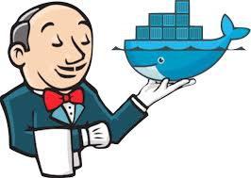
CI/CD with Docker
When your software is packaged in a Docker image, it becomes very easy to deploy in CI/CD environments for testing and other uses.
Can spin up an entire application stack and run a variety of tests and other interactions against it in a completely automated fashion.
No need for dedicated agents with specific sets of software installed for testing. Your agent just needs Docker and docker-compose.

Slide 123
Managing Diverse Codesets with Docker
Since Docker containers are self-contained environments, containers make it simple to manage diverse codesets across a variety of languages.
If a piece of software requires a certain language and/or other packages, just include them in the Docker image.
Helps address the “If all you have is a hammer, everything looks like a nail.” issue.
Lets you use the right tools and language for the job without having to worry about the underlying management of the software.

Slide 124
Managing Aging Applications with Docker
Docker makes it simple to provide customized environments for software and applications. This is especially useful for aging applications that may require a very particular set of older software to run.
Place these aging apps in containers so you don’t need to maintain dedicated environments for running them.
Don’t understand how an older app is deployed? It’s all defined in the Dockerfile!
No need to hunt down the resources that originally deployed the application.
When the application is EoL’d, just remove the container. The hardware it is running on is still useful for other applications.

Slide 125
Microservices and Distributed Systems
Well designed images that adhere to Docker best practices yield containers that are easily scalable and loosely coupled.
These two features are key ingredients for a distributed systems.
In effect, well designed containers are microservices and well designed container-based application stacks are distributed systems.
If you have well designed containers and container stacks, the only other critical component for a complete distributed system is a means of container orchestration, such as Kubernetes or Docker Swarm.

Slide 126
Cloud Migrations
Docker containers are widely supported across a variety of cloud providers.
This widespread support can be leveraged to ease application migrations to the cloud.
Once you have your application containerized, it becomes simple to move this application to run in a cloud-based Docker environment or on cloud hosts running Docker.

Slide 127
Container Orchestration beyond Docker-Compose
Orchestrating large collections of containers across multiple Docker hosts requires functionality beyond that offered by Docker-Compose.
There are a variety of container orchestration platforms that can be used to manage large collections of containers.
Several Major Container Orchestration platforms:
Kubernetes
Docker Swarm
Apache Mesos

Slide 128
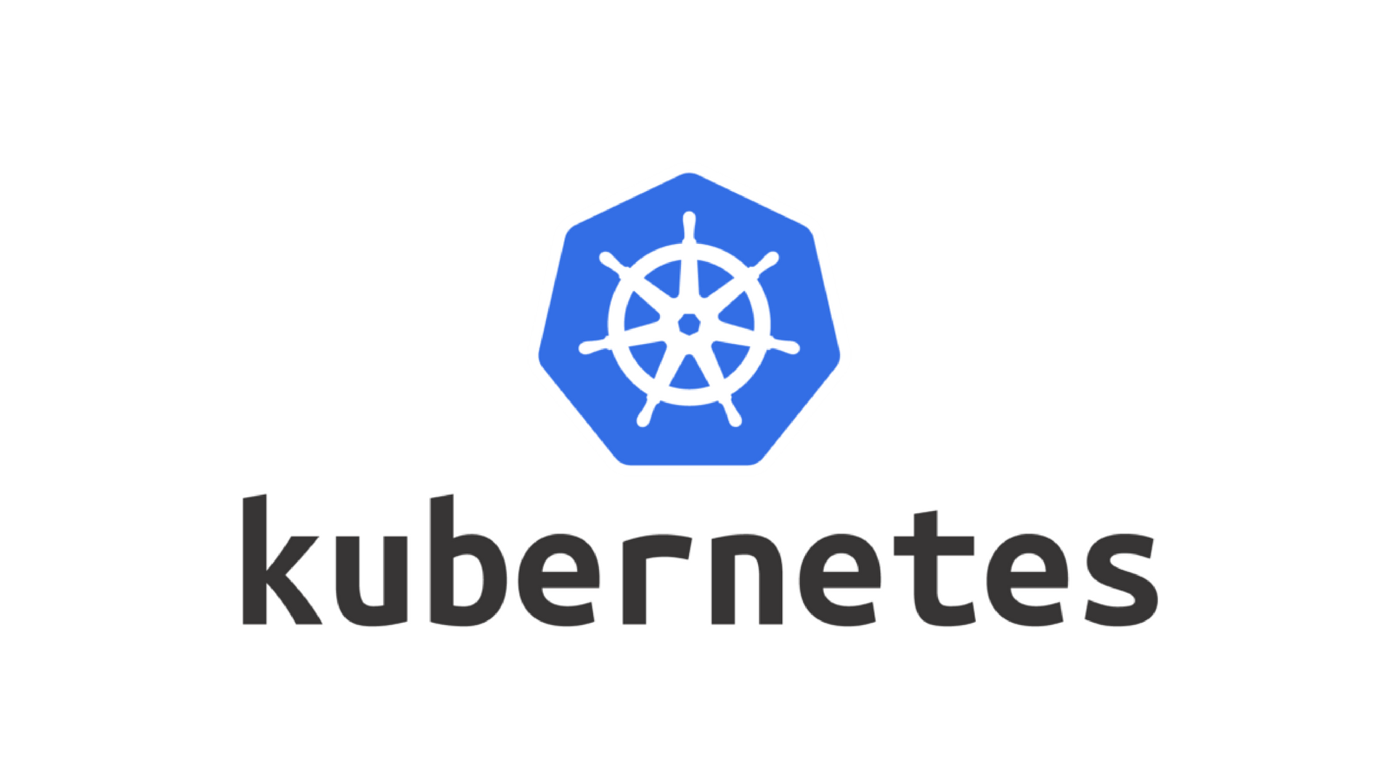
Kubernetes
Probably the most well known and adopted container orchestration platform.
Open source.
Developed by Google.
Integrated with many cloud providers, including AWS, GCP and Azure.
Can also be deployed on your own hardware.
Highly customizable and complex.
Steep learning curve.

Slide 129
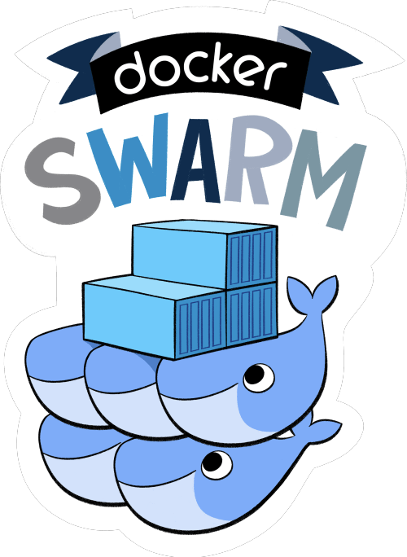
Docker Swarm
Integrated with Docker.
Allows a group of Docker hosts to be joined into a cluster.
Application stacks defined in docker-compose.yml files can be deployed into the swarm cluster via the docker stack command set.
Less of a learning curve than Kubernetes.
Lets you leverage docker-compose.yml files you may already have in a more distributed fashion.

Slide 130

Apache Mesos
Developed by the Apache Foundation
Open Source
Larger in scope than Kubernetes or Docker Swarm.
Aims to provide complete data center resource abstraction rather than just container orchestration.
Steep learning curve.
More complex to deploy than Kubernetes or Docker Swarm but offers more features.

Slide 131
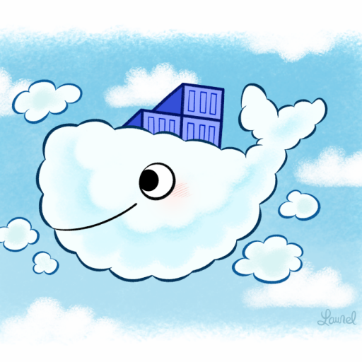
Cloud Provider Container Services
Most major cloud providers have support for running Docker containers.
AWS
ECS (Elastic Container Service)
ECR (Elastic Container Registry)
EKS (Elastic Kubernetes Service)
Fargate
GCP
Run containers on GCE instances
GCR (Google Container Registry)
Azure
Azure Container Instances
Azure Container Registry

Slide 132
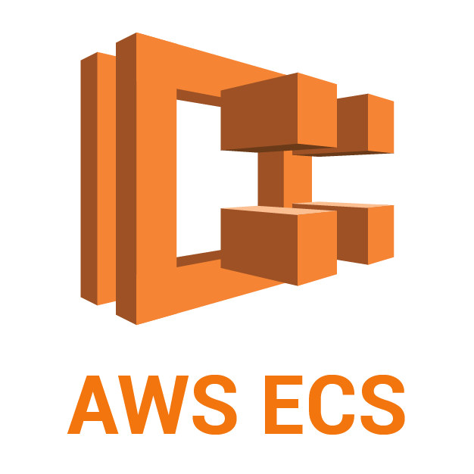
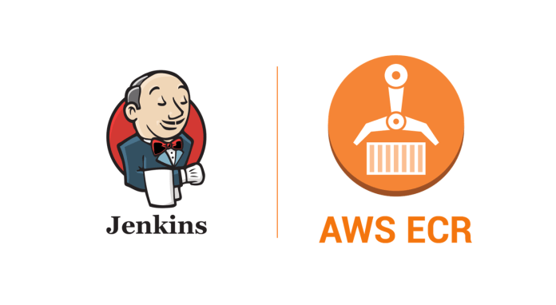


Docker and AWS
AWS has very robust support for containers.
ECS
AWS container orchestration service.
ECR
AWS hosted Docker image registry
EKS
AWS hosted Kubernetes
Fargate
Allows you to run containers without supporting servers.
Used by ECS.

Slide 133
Docker Success Stories - PayPal
PayPal is an online money transfer platform.
High volume, ~200 user payments per second across a variety of platforms (PayPal, Venmo, Braintree etc.)
Maintaining different platforms across architectures and clouds was time consuming and managing uptime was difficult.
Migrated 700+ applications to Docker Enterprise to enable a consistent operating platforms across cloud environments.
Currently run over 200,000 containers as part of their production infrastructure.
Achieved a 50% increase in productivity in building, testing and deploying applications via Docker

Slide 134
Docker Success Stories - Cornell University
Widely spread infrastructure and IT was difficult to coordinate, manage and support.
Diverse applications could not be unified to one common platform nor moved into a cloud environment.
Have migrated 49 applications to Docker containers and run more than 1000 containers on over 200 Docker Enterprise nodes in AWS.
Docker helped to simplify their build processes and architecture, leading to 13x faster application deployments.

Slide 135
Docker Success Stories - Indiana University
Desired to accelerate their application development process and migrate their 150 current applications by eliminating manual deployment steps.
Moved to adopt a microservices architecture.
Switched to using Docker to deploy all of their existing applications and new application platforms
Greatly improved their application packaging and deployment times by standardizing their application builds on Docker and eliminating manual steps needed to deploy and manage applications.

Slide 136
References
Docker CLI Reference
Dockerfile Reference
PayPal Customer Story
Cornell Customer Story
Indiana University Customer Story
AWS Docker Support
Kubernetes
Docker Swarm
Apache Mesos

Slide 137
Questions?

Slide 138

Thanks for Attending!

